Slide 1
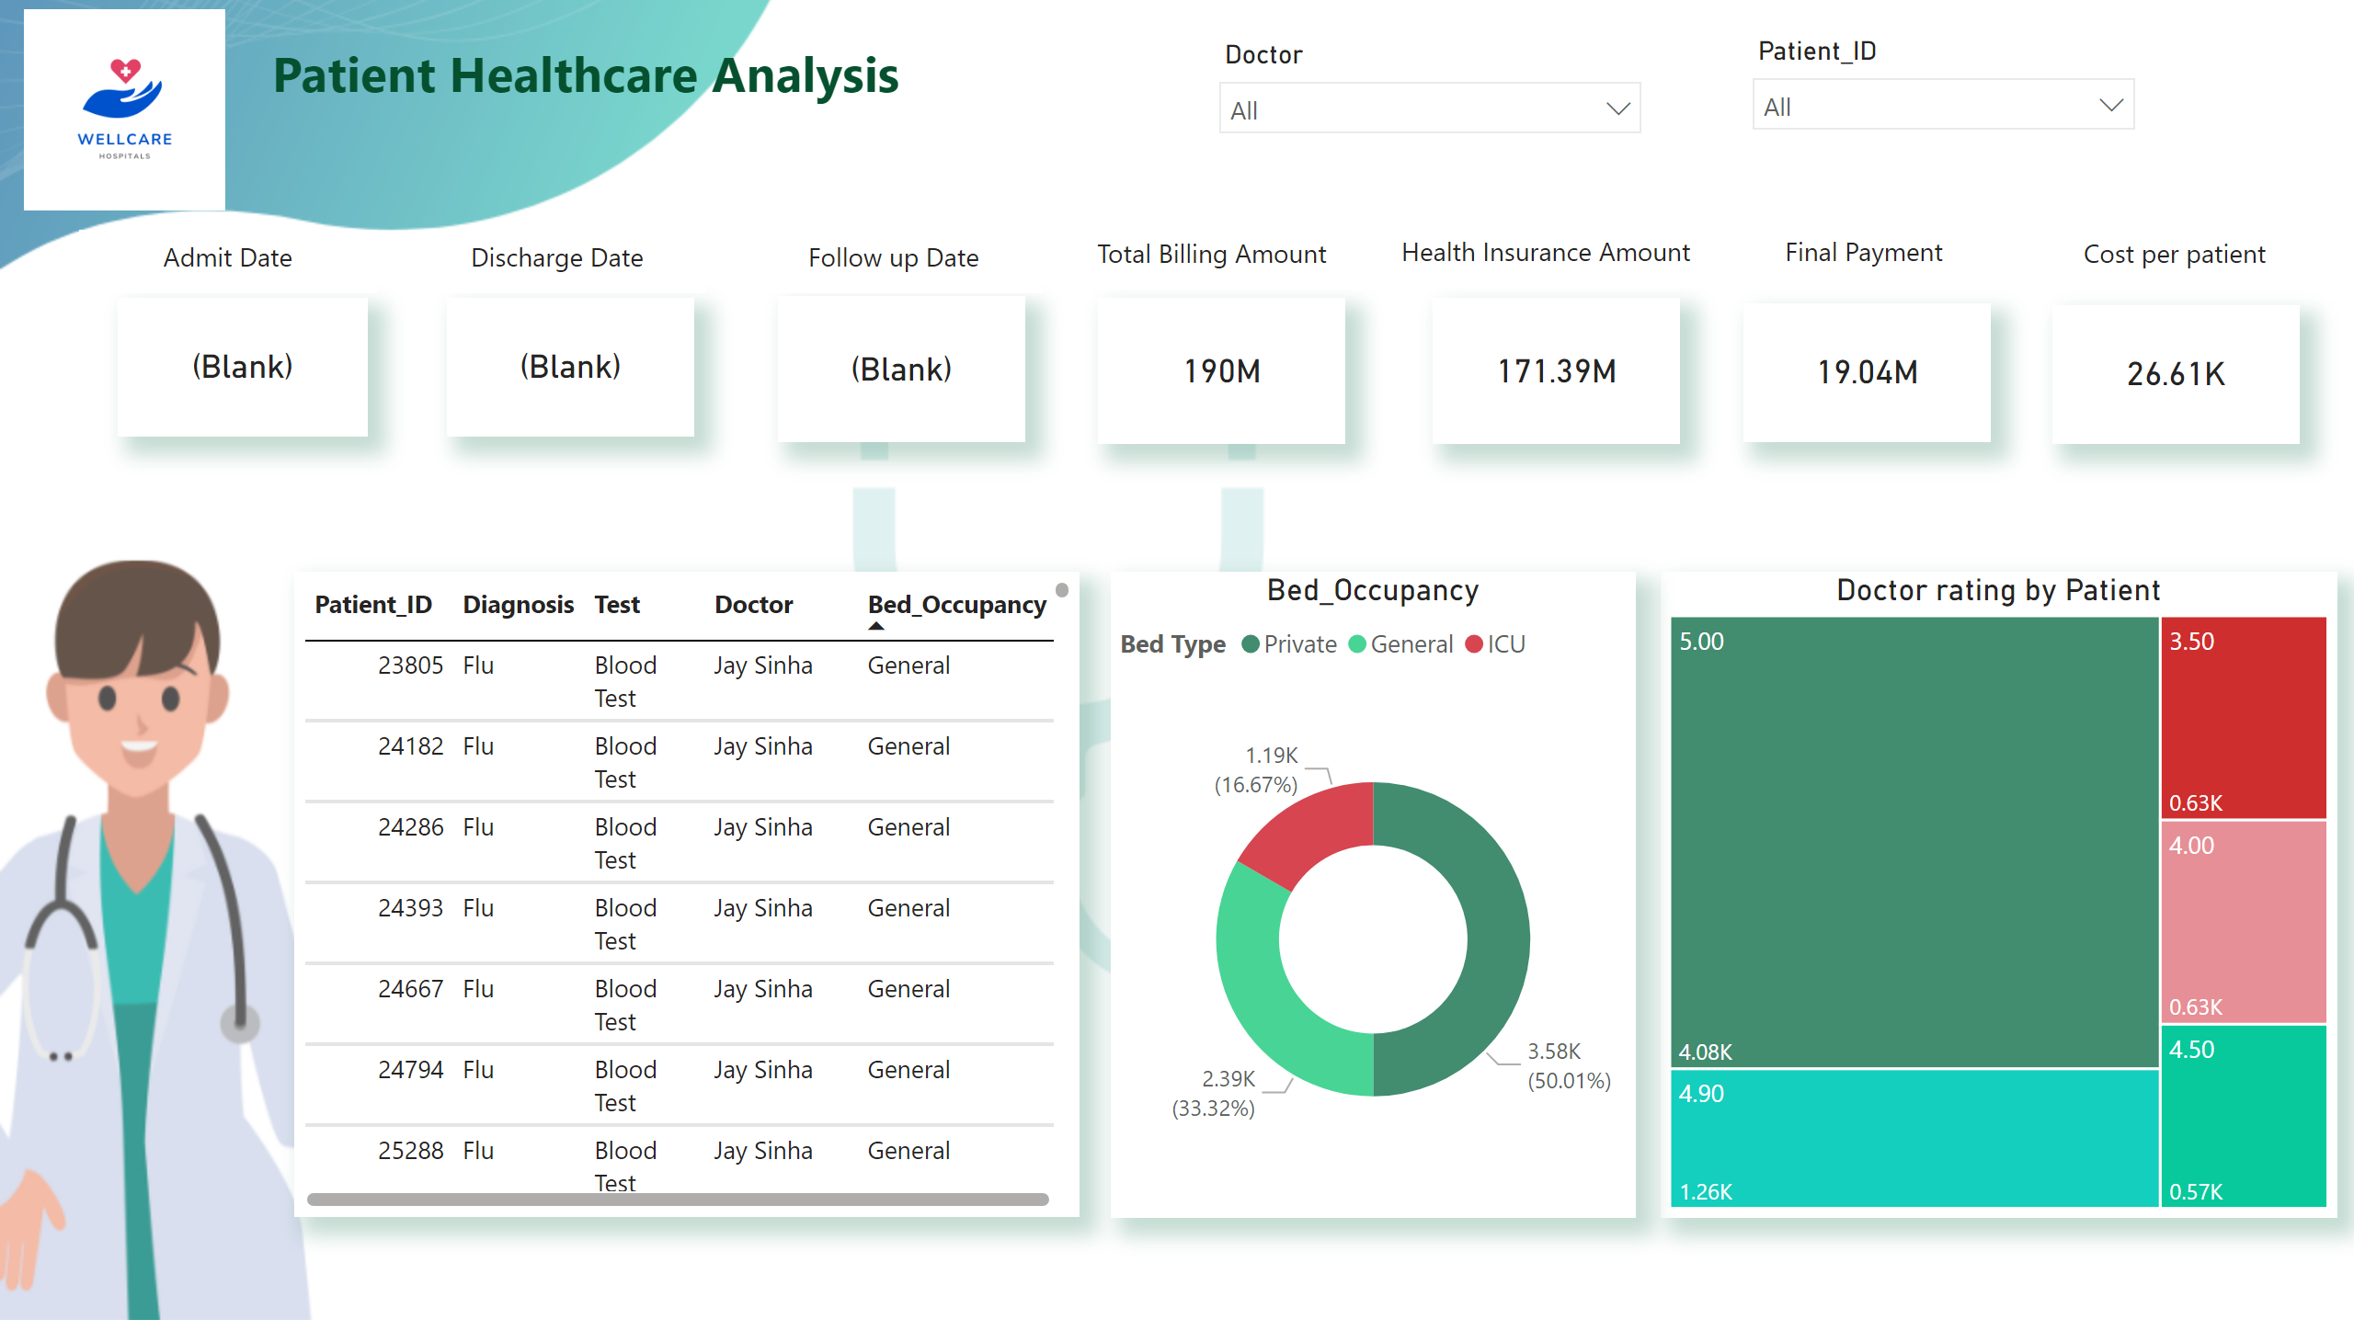
Patient Healthcare Analysis
Notes:
image
No alt text provided
Billing Amount
No alt text provided
card
No alt text provided
textbox
No alt text provided
textbox
No alt text provided
Doctor rating by Patient
No alt text provided
Billing Amount
No alt text provided
textbox
No alt text provided
slicer
No alt text provided
slicer
No alt text provided
Billing Amount
No alt text provided
Billing Amount
No alt text provided
textbox
No alt text provided
textbox
No alt text provided
Billing Amount
No alt text provided
textbox
No alt text provided
tableEx
No alt text provided
Bed_Occupancy
No alt text provided
textbox
No alt text provided
Billing Amount
No alt text provided
textbox
No alt text provided

Slide 2
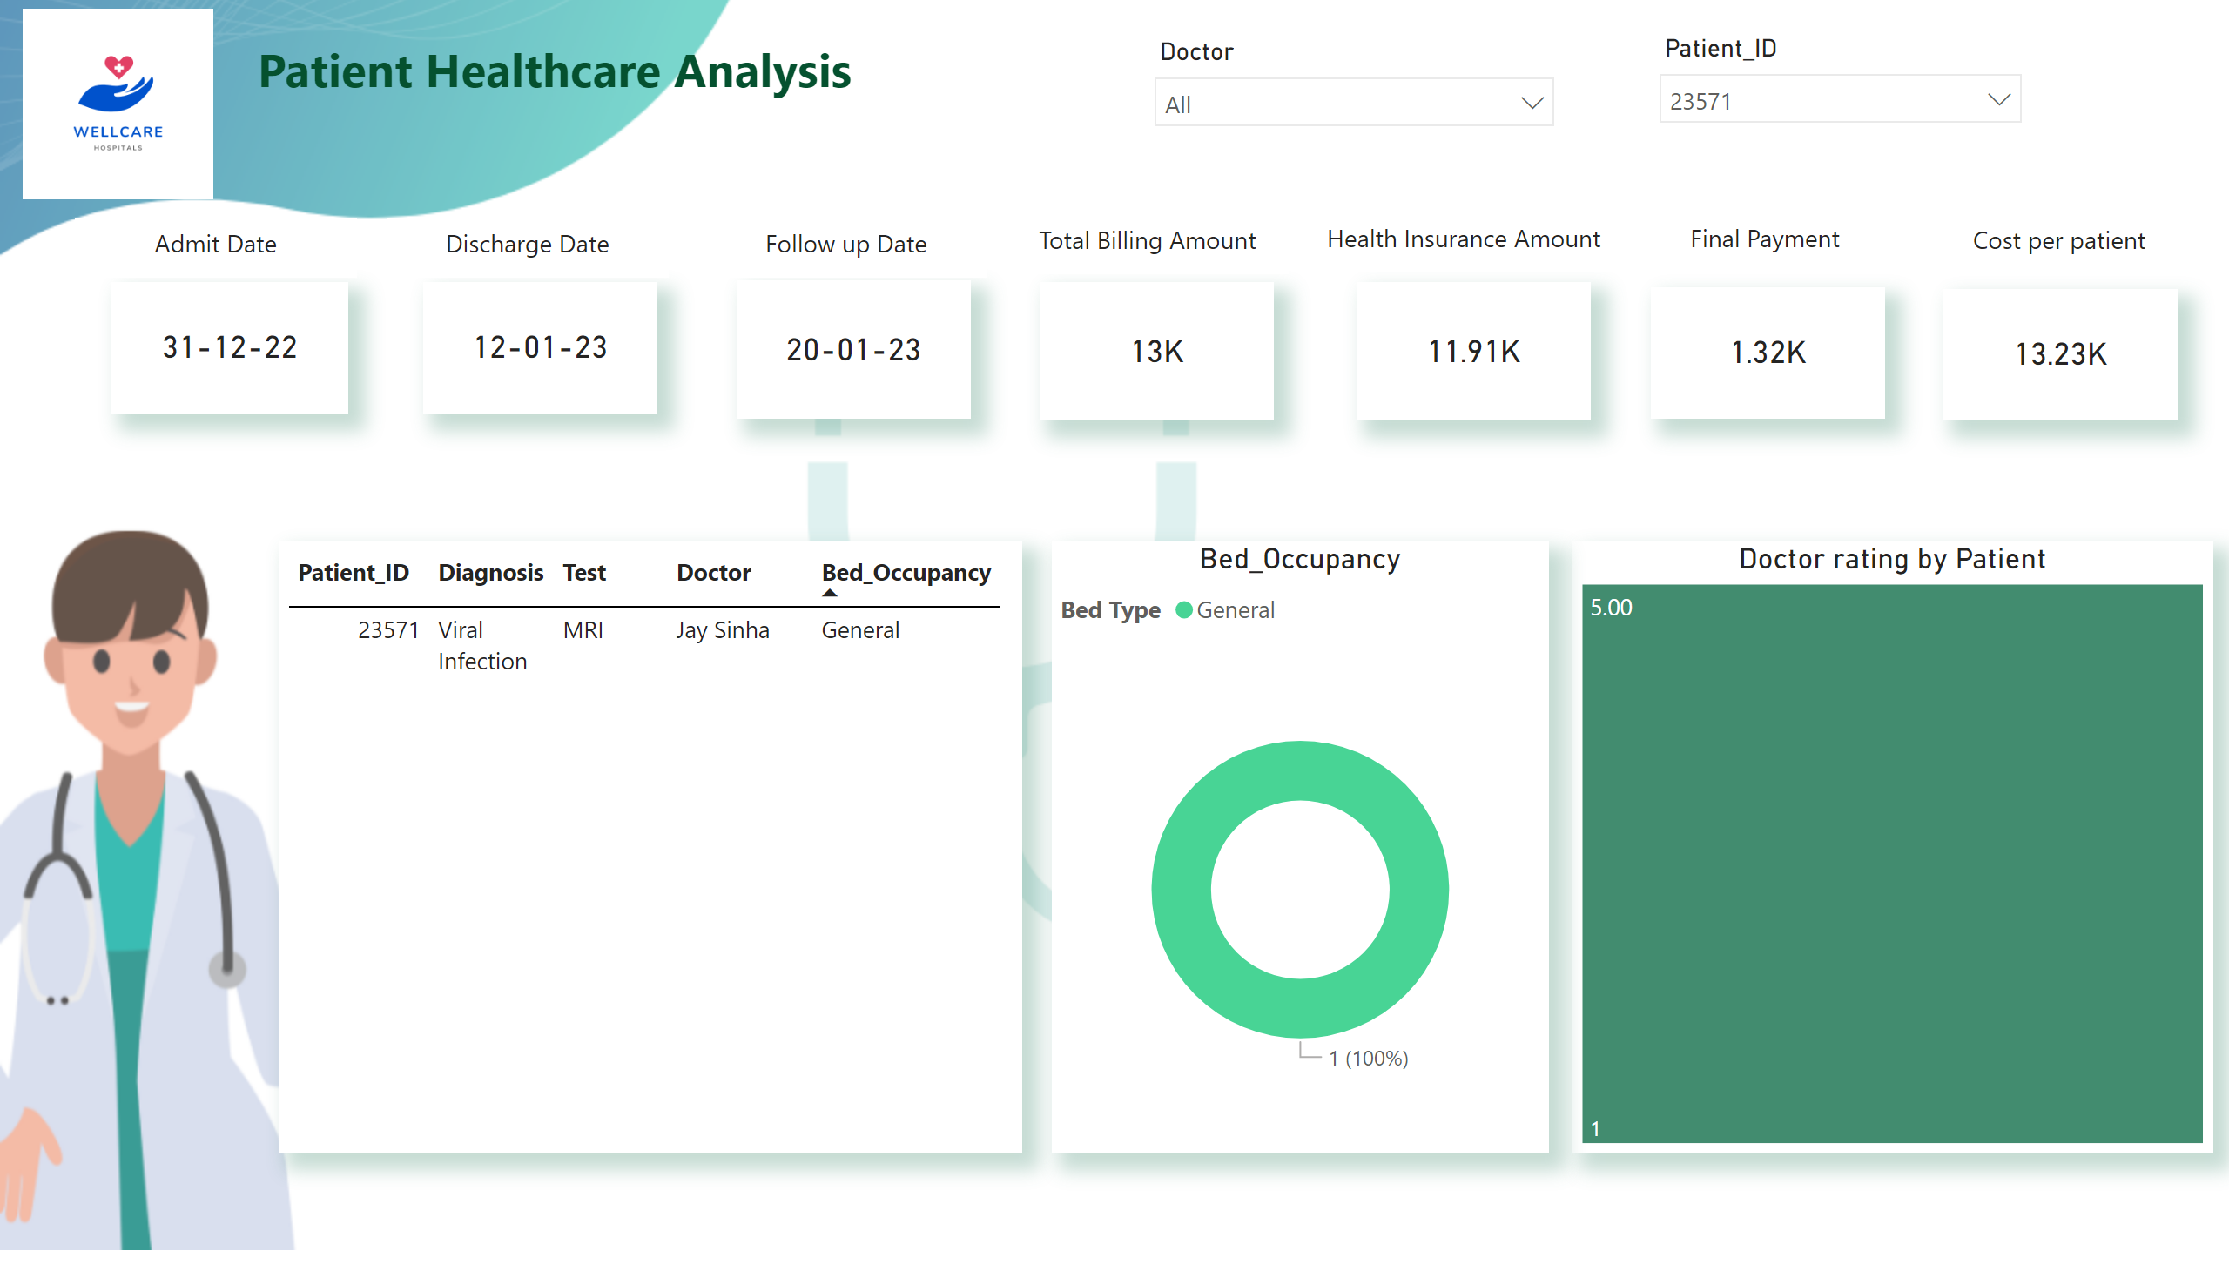
Patient Healthcare Analysis
Notes:
image
No alt text provided
Billing Amount
No alt text provided
card
No alt text provided
textbox
No alt text provided
textbox
No alt text provided
Doctor rating by Patient
No alt text provided
Billing Amount
No alt text provided
textbox
No alt text provided
slicer
No alt text provided
slicer
No alt text provided
Billing Amount
No alt text provided
Billing Amount
No alt text provided
textbox
No alt text provided
textbox
No alt text provided
Billing Amount
No alt text provided
textbox
No alt text provided
tableEx
No alt text provided
Bed_Occupancy
No alt text provided
textbox
No alt text provided
Billing Amount
No alt text provided
textbox
No alt text provided

